Slide 1


Building Shit University Web Template
Welcome to the WCAP Workshop Final Project by Tofus Wang. We're about to embark on a journey to simplify web design for the g0v community.
Presenter: Tofus Wang

Slide 2
The Problem We're Solving
The Challenge
Our Solution
Many g0v community members lack basic coding skills. They struggle to create webpages, unsure about essential elements.
We're providing a simple landing page template. It'll help members quickly grasp basic webpage structures, reducing design complexity and costs.

Slide 3

Design Concept: Keep It Simple
Intuitive Layout
Clear Structure
Focus on essential elements: header, content sections, and CTA.
Logical flow from top to bottom, guiding users through information.
Minimalist Approach
Clean design without unnecessary clutter or complexity.

Slide 4
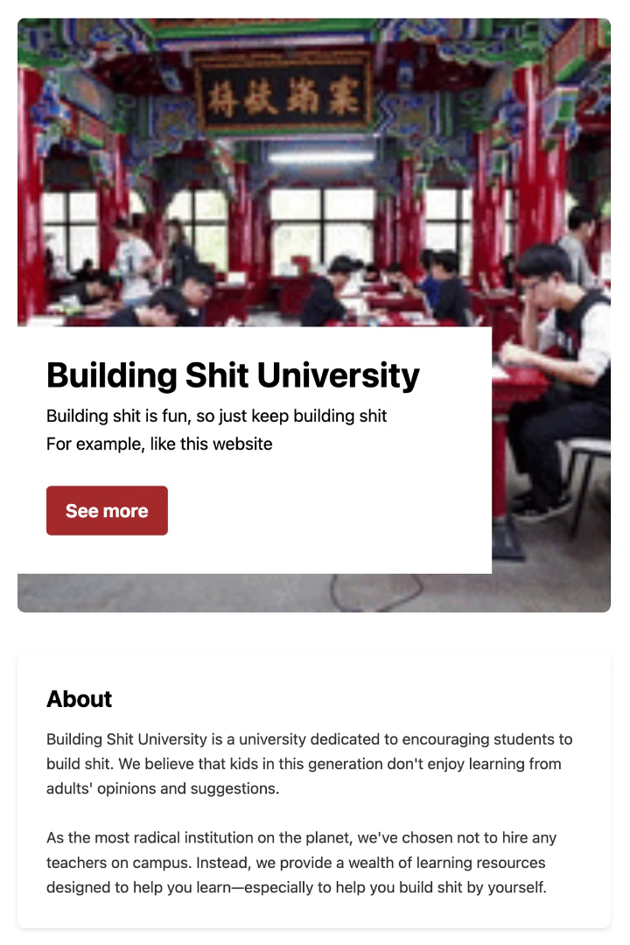



Website Preview: Key Sections
Header
Content Sections
Eye-catching site title and concise tagline to grab attention. With playful video created with Sora
About, features, and resources presented in a clear, scannable format.
CTA
Prominent call-to-action buttons guiding user engagement.

Slide 5
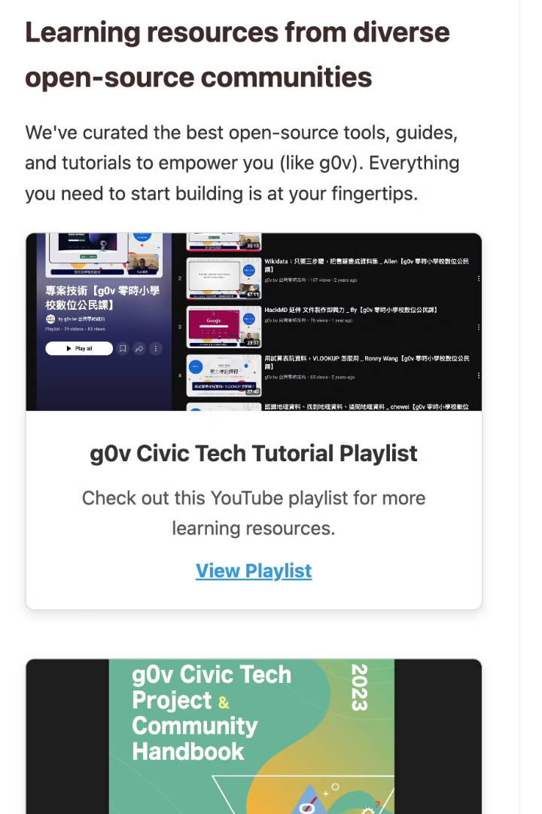
Highlights and Applications
Responsive Design
Clear Structure
Adapts seamlessly to different screen sizes, from mobile to desktop.
Intuitive layout that guides users through content effortlessly.
Open-Source Integration
Versatile Use
Incorporates g0v-inspired resources for community alignment.
Perfect for personal sites, event pages, and project showcases.

Slide 6

Future Improvements and Plans
1
Template Variations
Create diverse styles to suit different project needs.
2
Enhanced Customization
Offer more options for personalization without complexity.
3
Accessibility Boost
Ensure the template is usable by all, regardless of abilities.
4
Community Adoption
Promote template use across various g0v projects. Especially projects that lack of assistance from engineers.

Slide 7



Reflections on WCAP Training
Community Impact
1
Helping g0v members lower costs for building informational webpages.
Skills Gained
2
Understanding core website structures and making confident design decisions.
Foundation Built
3
Reduced reliance on complex frameworks, focus on essentials.

Slide 8




Thank You and Next Steps
Adopt
Use the template in your next g0v project.
Feedback
Share your experience to help improve the template.
Spread
Encourage others to try the Building Shit University Web Template.

